Slide 1
Footstep planning of walking robots
10601B project
March 24th

Slide 2
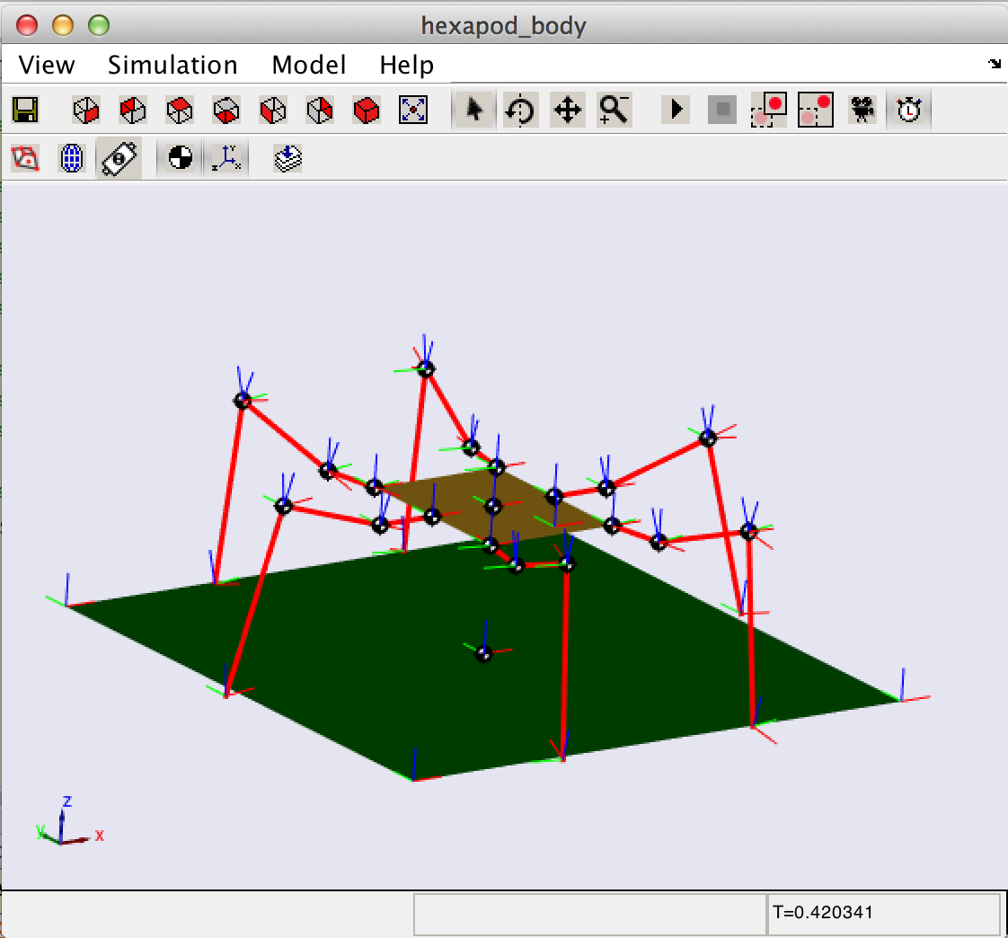
Hexapod robot model
Matlab Simmechanics
18 Degrees of Freedom, 3 Dof for every leg
Rough terrain with random height or real world

Slide 3
A big picture
Terrain data(height)
Terrain cost function (by machine learning)
Terrain cost map
High level Path planning
Low level footstep planning

Slide 4
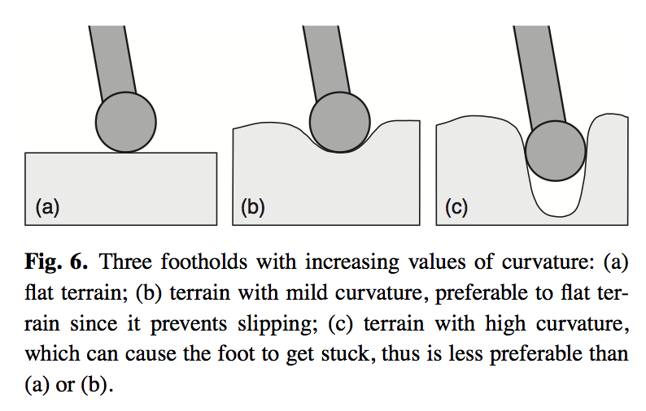
Terrain Cost function
f = w₁*height + w₂*angle + w₃*convexity

Slide 5
Potential approach
SVM (in paper An Optimization Approach to Rough Terrain Locomotion) => Supervised learning, L1-regularized regression
Apprenticeship learning(in paper Apprenticeship Learning via Inverse Reinforcement Learning)
CMA-ES (genetic algorithm) =>Bad
Reinforcement Learning

Slide 6
Milestone
Build robot model (by the end of the spring break)√
Add rough terrain (half-way )√
Design a cost function by machine learning (finish this by April 6th)√
Mid-way report. (we are working on this)

Slide 7
Cost function design
R(f)=w^{T}x
f is the position of footstep;
w is the weight vector;
x is the feature vector and x = {x_{1,} x_{2,} x_{3, …} x_{n}};
Each x_{i} is a terrain feature.

Slide 8
Terrain Feature
Height and slope => easy
concavity/convexity => hard to write in a mathematical format.
Instead, we use terrain templates to represent concavity/convexity

Slide 9
Terrain template + features
X has 53 features,
51 come from terrain templates (a group of terrains with different concavity and convexities)
2 come from terrain feature (height & slope)

Slide 10
Terrain Templates
Perfect

Slide 11
Terrain Templates
Good

Slide 12
Terrain Templates
Fair

Slide 13
Terrain Templates
Bad

Slide 14
Terrain Templates
Bad

Slide 15
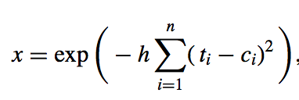
Terrain Template
Feature value
Training sample has n points.
t_{i} is the template height, c_{i} is the training sample height
h = 50 is a fixed kernel bandwidth
Every training sample has a fixed feature value

Slide 16
Experience from Expert
Random training data will be sent to the expert
Expert label this sample as good or bad
The classifier learns a linear separator w by l1-regularized LR
y = sgn(w^{T}x)

Slide 17
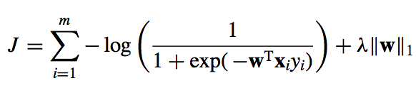
l1- regularized LR
Optimize J by sequential quadratic programming

Slide 18
Summary
The output of the classifier is w
As a milestone, we set up all the training environments(models, terrain visualization, cost function design).
We used some random training samples to find w, which is not very good in this phase.
We are going to find a perfect w for the rest of this semester.

